Slide 1
Repeated-measures designs (GLM 4)
Chapter 13

Slide 2
Terms
Between subjects = independent
Each subject gets only one level of the variable.
Repeated measures = within subjects = dependent = paired
Everyone gets all the levels of the variable.

Slide 3
RM ANOVA
Now we need to control for correlated levels though …
Before all levels were separate people (independence)
Now the same person is in all levels, so you need to deal with that relationship.

Slide 4
RM ANOVA
Sensitivity
Unsystematic variance is reduced.
More sensitive to experimental effects.
Economy
Less participants are needed.
But, be careful of fatigue.

Slide 5
RM ANOVA
Back to this term: Sphericity
Relationship between dependent levels is similar
Similar variances between pairs of levels
Similar correlations between pairs of levels
Called compound symmetry
The test for Sphericity = Mauchly’s
It’s an ANOVA of the DIFFERENCES in variance scores.

Slide 6
RM ANOVA
You will NOT need to examine sphericity if you have only two levels.
Why?

Slide 7
RM ANOVA
It is hard to meet the assumption of Sphericity
In fact, most people ignore it.
Why?
Power is lessened when you do not have correlations between time points
Generally, we find Type 2 errors are acceptable

Slide 8
RM ANOVA
Basic data screening: accuracy, missing, outliers
Outliers note … now you will screen all the levels … why? Screen in wide format!
Additivity – only to make sure it’s not r = .999+, otherwise will not run

Slide 9
RM ANOVA
Normality
Linearity
Homogeneity (NOT Levene’s, but Mauchly’s Sphericity)
Homoscedasticity

Slide 10
RM ANOVA
What to do if you violate it (and someone forces you to fix it)?
RM ANOVA with corrections
MANOVA
Multilevel Model

Slide 11
RM ANOVA
Corrections – note these are DF corrections → which affect the cut off score (you have to go further) → which lowers the p-value

Slide 12
RM ANOVA
Corrections:
Greenhouse-Geisser
Huynh-Feldt
Which one?
When ε (sphericity estimate) is > .75 = Huynh-Feldt
Otherwise Greenhouse-Geisser

Slide 13
An Example
Are some Halloween ideas worse than others?
Four ideas tested by 8 participants:
Haunted house
Small costume (brr!)
Punch bowl of unknown drinks
House party
Outcome:
Bad idea rating (1-12 where 12 is this was dummmbbbb).

Slide 14
Variance Components

Slide 15
Variance Components
SStotal = Me – Grand mean (so this idea didn’t change)
SSwithin = Me – My level mean (this idea didn’t change either)
BUT I’m in each level and that’s important, so …

Slide 16
Variance Components
SSwithin = SSmodel + SSresidual
SSmodel = My level – grand mean (same as between ANOVA)
SSresidual = SSwithin – SSmodel (basically, what’s left over after calculating how different I am from my level, and how different my level is the from the grand mean)

Slide 17
Variance Components
SSbetween?
Represents individual differences between participants
SSbetween = SStotal – Sswithin
“Peopleness”

Slide 18
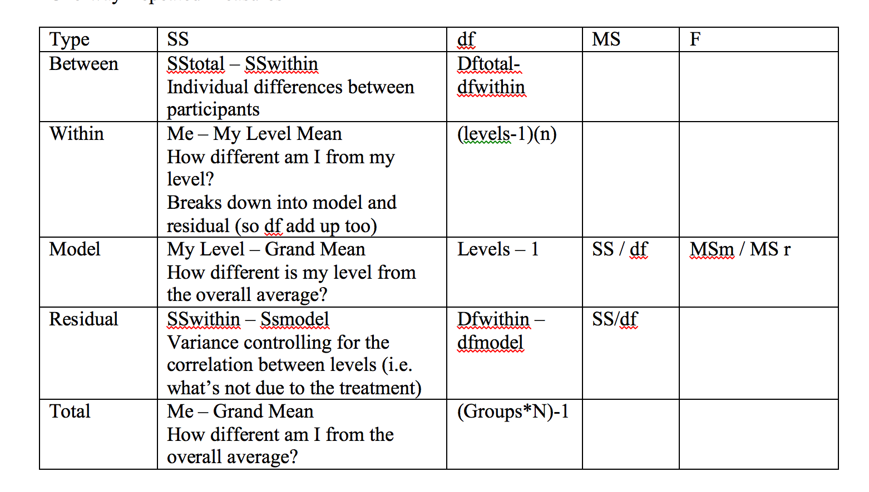

Slide 19
How to R
Data screening = run with wide format
Analysis = add a participant number, melt the data to get in the right format

Slide 20
How to R
ezANOVA(data = data,
dv = dv column,
within = iv column,
wid = partno,
detailed = TRUE,
type = 3)

Slide 21
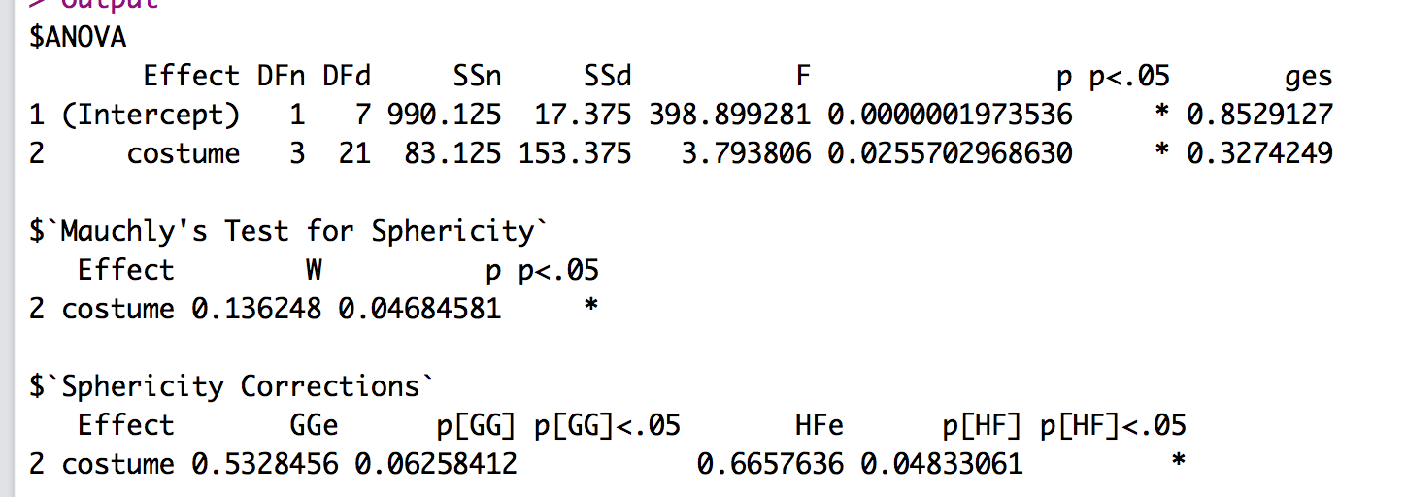
How to R
Mauchly’s is not significant W = 0.13, p = .05
F(3, 21) = 3.79, p = .03, η² = .33

Slide 22
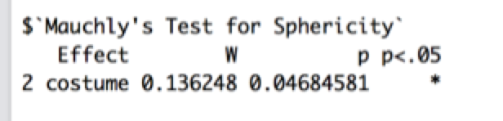
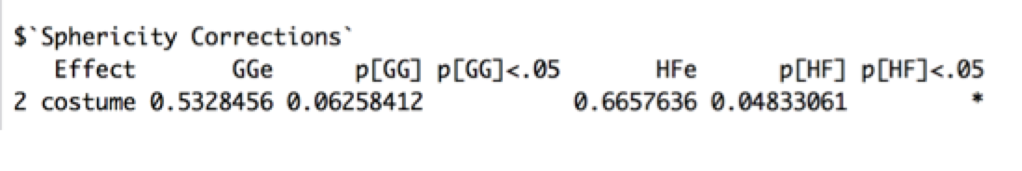
Correction?
Is it necessary?
Not by our data screening rules.
How do corrections work?

Slide 23
Correction?
Since HF < .75, I would use GG if I wanted to correct.
NOTE: traditionally, people would report the corrected df values.
However, since these values are not readily obvious here, you could just say Greenhouse-Geisser corrected p value and report the regular F.
F(3, 21) = 3.79, p = .03, Greenhouse-Geisser p = .06

Slide 24
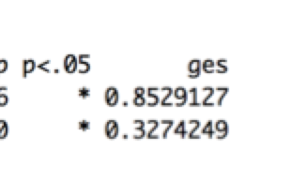
Effect Size
Eta squared = formula is still SSmodel / SStotal
But SStotal is a big pain in RM because you do not see all the variance calculations.

Slide 25
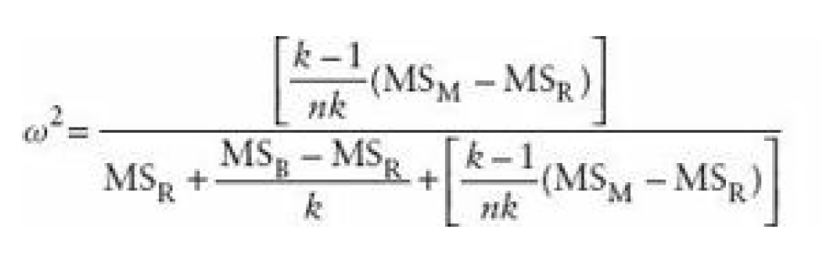
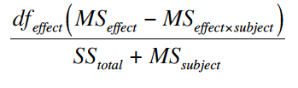
Effect Size
Omega squared is evil.
Let’s just not.

Slide 26
Post Hocs
Remember, this analysis is one-way repeated measures!
Because of the repeated measures part, we have to deal with independence in the post hoc as well.

Slide 27
Post Hoc Options
Things to get straight:
Post hoc test: dependent t
Why? Because it’s repeated measures data
Post hoc correction: Bonferroni

Slide 28
Post Hoc Options
Bonferroni:
pairwise.t.test(dataset$dv,
dataset$iv,
paired = T,
var.equal = T, #note
p.adjust.method = "bonferroni")

Slide 29
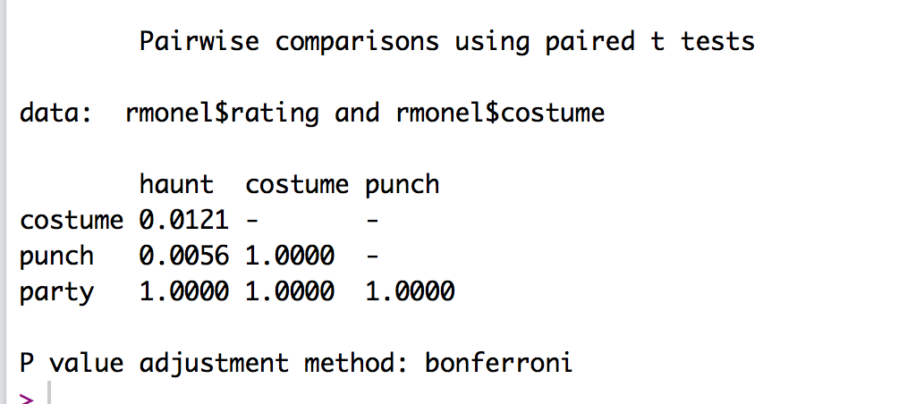
Post Hoc Options
Bonferroni output

Slide 30
Post Hoc Options
Group 1 | Group 2 | p | d
Haunt | Costume | .01 | 1.91
Haunt | Punch | .006 | 1.61
Haunt | Party | 1.00 | 0.92
Costume | Punch | 1.00 | 0.05
Costume | Party | 1.00 | -0.63
Punch | Party | 1.00 | -0.57
We run effect size the same as dependent t, where dav is your best bet.

Slide 31
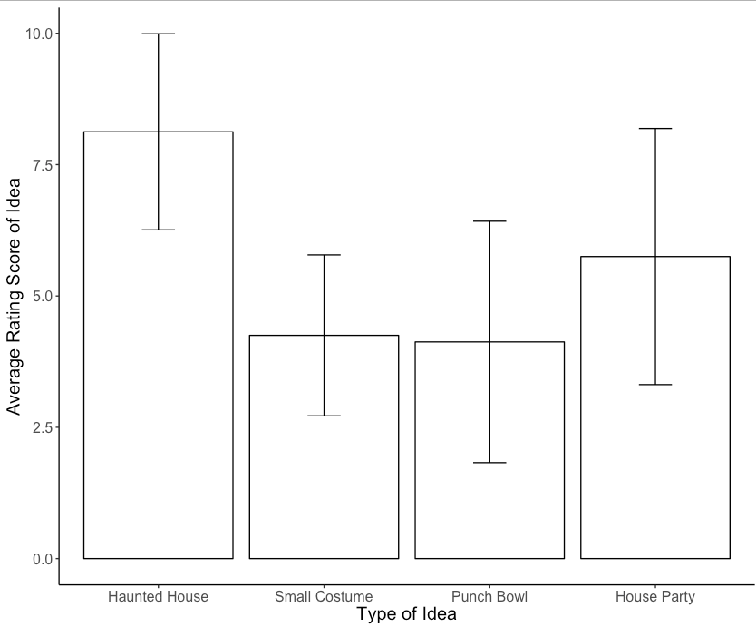

Slide 32
Power
Use the same power test as last week!
u = df model (numerator)
v = NULL
f2 = eta squared converted
sig.level = .05
Power = .80

Slide 33
Two-Way Repeated Measures ANOVA
Chapter 14

Slide 34
What is Two-Way Repeated Measures ANOVA?
Two Independent Variables
The same participants in all conditions.
Repeated Measures = ‘same participants’
A.k.a. ‘within-subjects’
Remember, we talked about using #X# repeated measures to describe the analysis.

Slide 35
An Example
Field (2013): Effects of advertising on evaluations of different drink types.
IV 1 (Drink): Beer, Wine, Water
IV 2 (Imagery): Positive, negative, neutral
Dependent Variable (DV): Evaluation of product from -100 dislike very much to +100 like very much)

Slide 36
SS_{T}
Variance between all participants
SS_{M}
Within-Participant Variance Variance explained by the experimental manipulations
SS_{R}
Between-Participant Variance
SS_{A}
Effect of Drink
SS_{B}
Effect of Imagery
SS_{A × B}
Effect of Interaction
SS_{RA}
Error for Drink
SS_{RB}
Error for Imagery
SS_{RA × B}
Error for Interaction

Slide 37
How to R
Data screen in wide format
Set up the data
Add a participant number
Melt the data
Fix the columns
gl function
gl(# levels, # cases in each level, # total cases, labels = c(“stuff”))

Slide 38
How to R
Using the ezANOVA function, we will now just add more variables
Change within to within = .(var, var), just like two way between subjects.

Slide 39
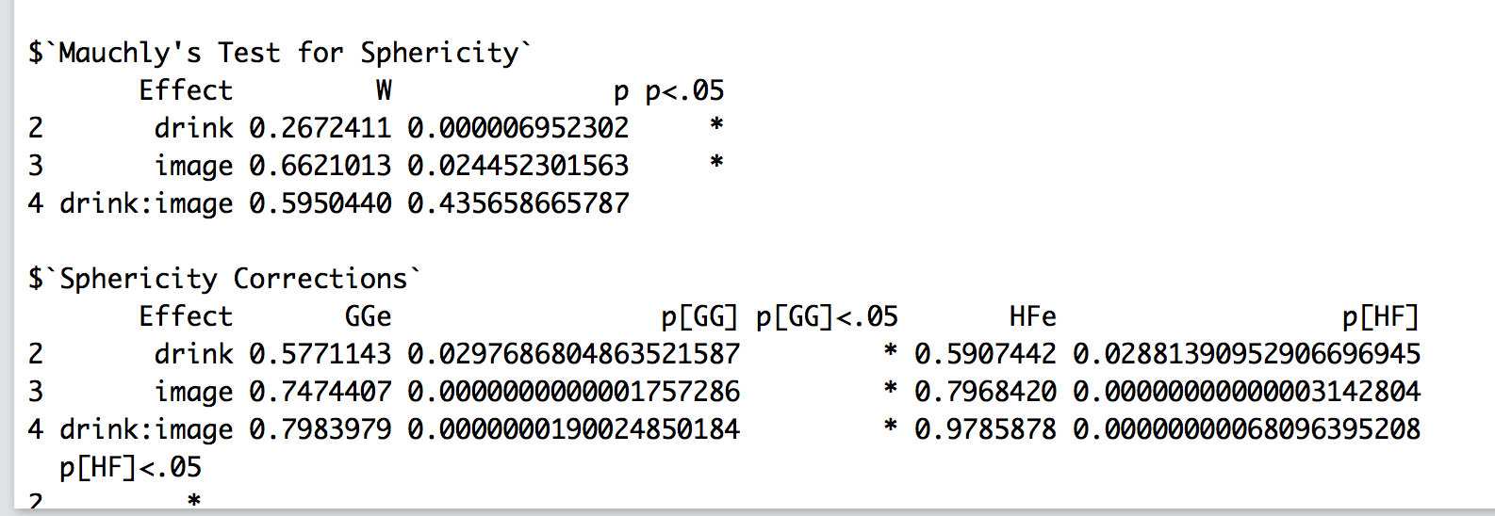
Definitely need to fix (a) drink!

Slide 40
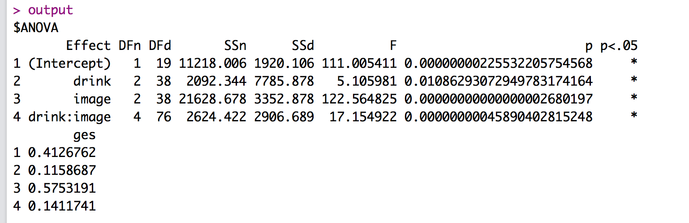
DRINK: F(2, 38) = 5.11, p = .01, Greenhouse-Geisser p = .03, η_{ges}² = .12
IMAGERY: F(2, 38) = 122.56, p < .001, η_{ges}² = .58
INTERACTION: F(4, 76) = 17.15, p = .03, η_{ges}² = .14

Slide 41
All the effects!
What now?
You can analyze main effects and interactions or just interactions
Given examples in code how to do both.

Slide 42
Simple Effects Analysis
Pick a direction – across or down!
How many comparisons does that mean we have to do?

Slide 43
Simple Effects Analysis
Same rules apply as two way between
Split the data:
First SPLIT by the larger number of levels.
Let’s split by imagery, since they are equal here.
Then analyze the data:
Analyze by only the other variable (drink).
Repeat for each data set.

Slide 44
Simple Effects Analysis
Group 1 | Group 2 | p | d
Positive Beer | Positive Wine | .69 | -0.44
Positive Beer | Positive Water | 1.00 | 0.36
Positive Wine | Positive Water | .006 | 1.15
Negative Beer | Negative Wine | <.001 | 1.40
Negative Beer | Negative Water | .02 | 1.13
Negative Wine | Negative Water | .47 | -0.43
Neutral Beer | Neutral Wine | 1.00 | -0.20
Neutral Beer | Neutral Water | .06 | 0.89
Neutral Wine | Neutral Water | <.001 | 1.36
With a large number of post hoc tests, it is easier to make a table.

Slide 45
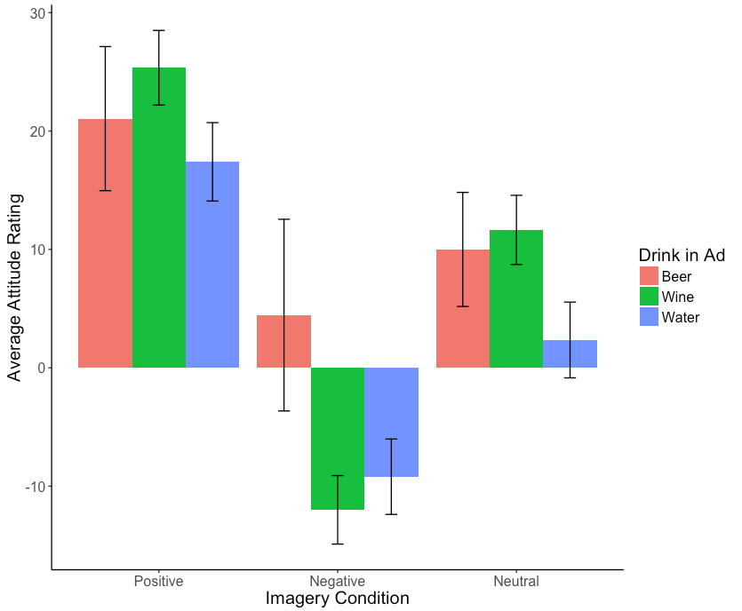

Slide 46
Power
Use the same power test as last week!
u = df model (numerator)
v = NULL
f2 = eta squared converted
sig.level = .05
Power = .80

